Slide 1
Chapter 1
Introduction to Design Principles
Course: Software Design & Architecture
Dep’t: 3rd year software engineering (R)
By Tilaye H.(MSc)
Address : B-601
IT office IV

Slide 2
Software Architecture, definition
The architecture of a software system defines the system in terms of computational components and interactions among those components.
(from Shaw and Garlan, Software Architecture, Perspectives on an Emerging Discipline, Prentice-Hall, 1996.)
Software architecture refers to the fundamental structures of a software system and the discipline of creating such structures and systems.
Each structure comprises software elements, relations among them, and properties of both elements and relations.

Slide 3
Architecture vs. Design
Architecture serves as a blueprint for a system. It provides an abstraction to manage the system complexity and establish a communication and coordination mechanism among components.
It defines a structured solution to meet all the technical and operational requirements, while optimizing the common quality attributes like performance and security.
Further, it involves a set of significant decisions about the organization related to software development and each of these decisions can have a considerable impact on quality, maintainability, performance, and the overall success of the final product.
These decisions comprise of :−
Selection of structural elements and their interfaces by which the system is composed.
Behavior as specified in collaborations among those elements.
Composition of these structural and behavioral elements into large subsystem.
Architectural decisions align with business objectives.
Architectural styles guide the organization.

Slide 4
Architecture vs. Design…
Software design provides a design plan that describes the elements of a system, how they fit, and work together to fulfill the requirement of the system. The objectives of having a design plan are as follows −
To negotiate system requirements, and to set expectations with customers, marketing, and management personnel.
Act as a blueprint during the development process.
Guide the implementation tasks, including detailed design, coding, integration, and testing.
It comes before the detailed design, coding, integration, and testing and after the domain analysis, requirements analysis, and risk analysis.

Slide 5
Architecture vs. Design…
Architecture: where non-functional decisions are cast, and functional requirements are partitioned
Design: where functional requirements are accomplished
architecture
Non-functional Requirements
design
Functional Requirements (Domains)

Slide 6
Goals of software architecture
The primary goal of the architecture is to identify requirements that affect the structure of the application.
A well-laid architecture reduces the business risks associated with building a technical solution and builds a bridge between business and technical requirements.
Some of the other goals are as follows −
Expose the structure of the system, but hide its implementation details.
Realize all the use-cases and scenarios.
Try to address the requirements of various stakeholders.
Handle both functional and quality requirements.
Reduce the goal of ownership and improve the organization’s market position.
Improve quality and functionality offered by the system.
Improve external confidence in either the organization or system.

Slide 7
Software Architecture & Quality
The notion of quality is central in software architecting: software architecture is devised to gain insight in the qualities of a system at the earliest possible stage.
Some qualities are observable via execution: performance, security, functionality etc.
And some are not observable via execution: portability, reusability, integrability, testability

Slide 8
Role of Software Architect
Excellent software engineering skills
Lead technical development team by example
Solve the hard problems
Understand impact of decisions
Defend architectural design decisions
Know and understand relevant technology
Track technology development
Notes:
Externally visible: so you are abstracting from something
architecture defines components; only their interaction counts, not their internals.
Every system has an architecture, and this architecture is not the same as its description (see also next IEEE definition)
Architecture can be good or bad: hence evaluation
Process: how do you get an architecture.
Rules: what should be/not be, in an architecture?

Slide 9
Design
Definition:
Design is a problem-solving process whose objective is to find and describe a way:
To implement the system’s functional requirements while respecting the constraints imposed by the quality and budget.”

Slide 10
Design as a series of decisions
A designer is faced with a series of design issues:
Each issue normally has several alternative solutions:
design options
The designer makes a design decision to resolve each issue.
This process involves choosing the best option from among the alternatives.
Making decisions- To make each design decision, the software engineer uses:
Knowledge of
the requirements
the design as created so far
the technology available
software design principles

Slide 11
Design space
The space of possible designs that could be achieved by choosing different sets of alternatives is often called the design space
For example:
Programmed in Java
Client/Server
Fat Client
Programmed in Visual Basic
Monolithic
Thin Client
Programmed in C++

Slide 12
Principles Leading to Good Design
Overall goals of good design:
Increasing profit by reducing cost and increasing revenue
Ensuring that we actually conform with the requirements
Accelerating development
Increasing qualities such as:
Changeability
Extensibility
Reusability

Slide 13
Changeability
Existing requirements change and new ones are added.
To reduce maintenance costs and the workload involved in changing an application, it is important to prepare its architecture for modification and evolution.
Two reasons why software ages:
Lack of movement -software ages if it is not frequently updated.
Ignorant surgery -changes made by people who do not understand the original design, gradually destroy the architecture.

Slide 14
Extensibility
This focuses on the extension of a software system with new features, as well as the replacement of components with improved versions and the removal of unwanted or unnecessary features and components.
To achieve extensibility a software system requires loosely-coupled components.

Slide 15
Reusability
It promises a reduction of both cost and development time for software systems, as well as better software quality.
Reusability has two major aspects- software development with reuse and software development for reuse:
Software development with reuse means reusing existing components and results from previous projects or commercial libraries or code components.
Software development for reuse focuses on producing components that are potentially reusable in future projects as part of the current software development.

Slide 16
Design Principle 1: Divide and conquer
Trying to deal with something big all at once is normally much harder than dealing with a series of smaller things.
Separate people can work on each part.
An individual software engineer can specialize.
Each individual component is smaller, and therefore easier to understand.
Parts can be replaced or changed without having to replace or extensively change other parts.

Slide 17
Ways of dividing a software system
A distributed system is divided up into clients and servers
A system is divided up into subsystems
A subsystem can be divided up into one or more packages
A package is divided up into classes
A class is divided up into methods

Slide 18
Design Principle 2: Increase cohesion where possible
A subsystem or module has high cohesion if it keeps together things that are related to each other, and keeps out other things
This makes the system as a whole easier to understand and change
Type of cohesion:
Functional, Layer, Communicational, Utility

Slide 19
Functional cohesion
This is achieved when all the code that computes a particular result is kept together - and everything else is kept out
i.e. when a module only performs a single computation, and returns a result, without having side-effects.
Benefits to the system:
Easier to understand
More reusable
Easier to replace
Modules that update a database, create a new file or interact with the user are not functionally cohesive

Slide 20
Layer cohesion
All the facilities for providing or accessing a set of related services are kept together, and everything else is kept out
The layers should form a hierarchy
Higher layers can access services of lower layers,
Lower layers do not access higher layers
The set of procedures through which a layer provides its services is the application programming interface (API)
You can replace a layer without having any impact on the other layers
You just replicate the API

Slide 21
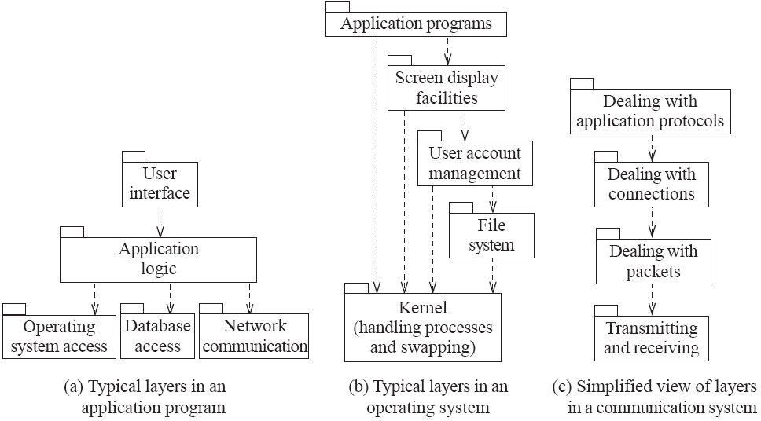
Example of the use of layers

Slide 22
Communicational cohesion
All the methods that access or manipulate certain data are kept together (e.g. in the same class) - and everything else is kept out
A class would have good communicational cohesion
If all the system’s facilities for storing and manipulating its data are contained in this class.
Main advantage: When you need to make changes to the data, you find all the code in one place
Example- StudentManager class (insert, update, delete, search etc.)

Slide 23
Utility cohesion
When related utilities which cannot be logically placed in other cohesive units are kept together
A utility is a procedure or class that has wide applicability to many different subsystems and is designed to be reusable.
For example, the java.lang.Math class.

Slide 24
Design Principle 3: Reduce coupling where possible
Coupling occurs when there are interdependencies between one module and another
When interdependencies exist, changes in one place will require changes somewhere else.
A network of interdependencies makes it hard to see at a glance how some component works.
Type of coupling:
Common, Control, Routine Call

Slide 25
Common coupling
Occurs whenever you use a global variable
All the components using the global variable become coupled to each other
can be acceptable for creating global variables that represent system-wide default values
The best way is declare all the global variables in an interface
and use them through interface
The Singleton pattern provides encapsulated global access to an object

Slide 26
Control coupling
Occurs when one procedure calls another using a ‘flag’ or ‘command’ that explicitly controls what the second procedure does
To make a change you have to change both the calling and called method
The use of polymorphic operations is normally the best way to avoid control coupling
One way to reduce the control coupling could be to have a look-up table
commands are then mapped to a method that should be called when that command is issued

Slide 27
Routine call coupling
Occurs when one routine (or method in an object oriented system) calls another
The routines are coupled because they depend on each other’s behaviour
Routine call coupling is always present in any system.
If you repetitively use a sequence of two or more methods to compute something
then you can reduce routine call coupling by writing a single routine that encapsulates the sequence.
Method foo{
B();
C();
D();
..
B();
C();
D();
}
Method foo(){
Bcd();
..
Bcd();
}
Method bcd(){
B();
C();
D();
}

Slide 28
Design Principle 4: Keep the level of abstraction as high as possible
Ensure that your designs allow you to hide or defer consideration of details, thus reducing complexity
A good abstraction is said to provide information hiding
Abstractions allow you to understand the essence of a subsystem without having to know unnecessary details

Slide 29
Abstraction and classes
Classes are data abstractions that contain procedural abstractions
Abstraction is increased by defining all variables as private.
The fewer public methods in a class, the better the abstraction
abstract classes and interfaces increase the level of abstraction

Slide 30
Design Principle 5: Increase reusability where possible
Design the various aspects of your system so that they can be used again in other contexts
Generalize your design as much as possible

Slide 31
Design Principle 6: Reuse existing designs and code where possible
Design with reuse is complementary to design for reusability
Actively reusing designs or code allows you to take advantage of the investment you or others have made in reusable components.

Slide 32
Design Principle 7: Design for flexibility
Actively anticipate changes that a design may have to undergo in the future, and prepare for them
Reduce coupling and increase cohesion
Create abstractions
Do not hard-code anything
Use reusable code and make code reusable

Slide 33
Design Principle 8: Anticipate obsolescence
Plan for changes in the technology or environment so the software will continue to run or can be easily changed
Avoid using early releases of technology
Avoid using software libraries that are specific to particular environments
Use standard languages and technologies that are supported by multiple vendors

Slide 34
Design Principle 9: Design for Portability
Have the software run on as many platforms as possible
Avoid the use of facilities that are specific to one particular environment
E.g. a library only available in Microsoft Windows

Slide 35
Design Principle 10: Design for Testability
Take steps to make testing easier
Design a program to automatically test the software
Ensure that all the functionality of the code can be driven by an external program, bypassing a graphical user interface
In Java, you can create a main() method in each class in order to exercise the other methods

Slide 36
Design Principle 11: Design defensively
Never trust how others will try to use a component you are designing
Handle all cases where other code might attempt to use your component inappropriately means check that all of the inputs to your component are valid: the preconditions
Validate the user input before using in your program

Slide 37
Questions ?

